Slide 1


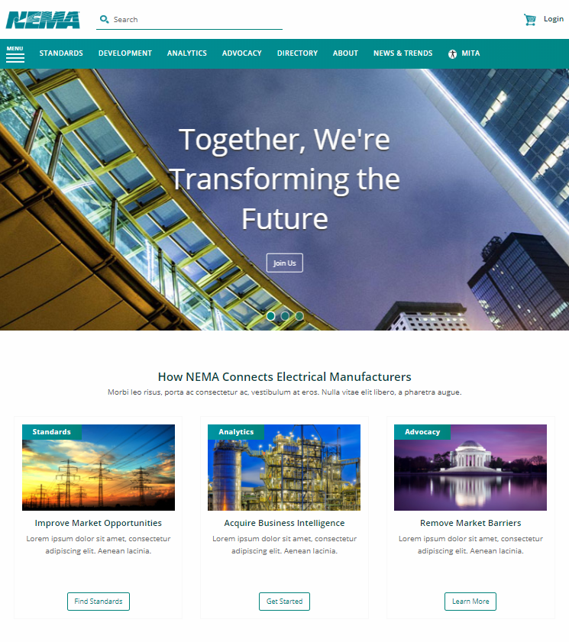
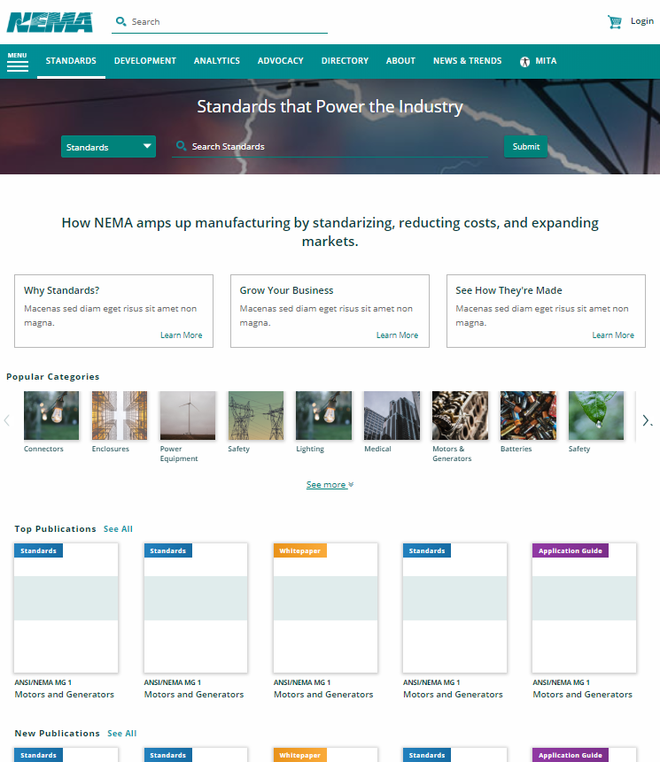

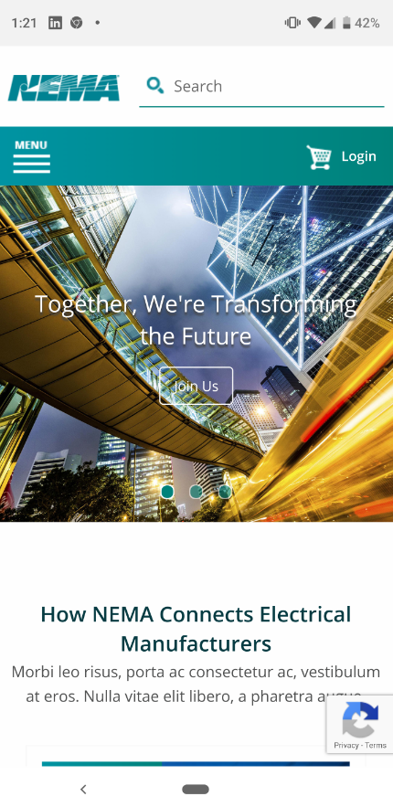
NEMA
Who They Are The National Electrical Manufacturers Association (NEMA) represents nearly 400 electrical, medical imaging, and radiation therapy manufacturers on the forefront of electrical safety, reliability, resilience, efficiency, and energy security.
Business Need
NEMA is looking to revamp the website to modernized the NEMA, MITA, and DICOM brands and increase the visibility of the organization. The solution needs to align with the three brands to engage the audience as well as position NEMA as the leading leader in electro industry. The research and design has been provided by Zurb. NEMA is looking for a partner to develop a unified platform with personalized content, user-friendly, and easy to navigate for the stakeholders. NEMA hopes to increase advertising revenue with expanded ad inventory, contextual placements, and cross–promotions.
What We Did NEMA has been emphatically satisfied with Affirma’s ability to migrate NEMA’s previous site content to a full functioning, responsive website built on the Sitefinity platform and meeting all defined success criteria. Built with a modern and inviting user experience, it delivers consistent look and feel across all pages and browsers. It has the ability to publish a fully searchable NEMA magazine while delivering ease of use for both site visitors and stakeholders.

